Slide 1


purchases of
IN-GAME content: survey on parental supervision
A REPORT BY IPSOS FOR VIDEO GAMES EU
April 2026

Slide 2


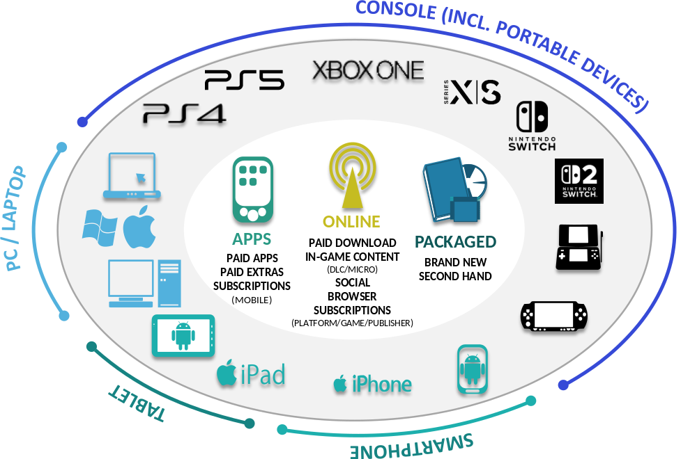


TOTAL UNDERSTANDING OF THE VIDEO GAME MARKET
VIDEO GAME PLAYERS
(REACH & SIZE)
ENGAGEMENT
(GAMING TIME)
REVENUE
(VIDEO GAME SALES)
All devices
Consoles, PCs, Smart Devices, Children devices & Internet TVs
All formats
Physical, Online, Apps & Subscriptions
Broader demographic
6-75 yrs old population
Larger geographic coverage
16 markets within Europe
Online + Offline method
c3,000/2,000 yearly online surveys +
c1,000 F2F surveys every three years
13 years of results
long lasting tracking study
(Europe5)
EXTERNAL DATA FROM VIDEO GAME SALES
GameTrack 2025 methodology has undergone revisions, generating limitations for like-for-like comparisons due to changes in sample definitions, questionnaire and methodology. Revenue estimates now integrate a wider set of subscriptions to video game services.

Slide 3
METHODOLOGY:
PURCHASES OF IN-GAME CONTENT: SURVEY ON PARENTAL SUPERVISION
2025: ONCE A YEAR ONLINE FIELDWORK ACROSS EU16 MARKETS
(UP TO 2024 MONTHLY FIELDWORK ACROSS EU5 MARKETS)
Since 2018, Ipsos has conducted research on behalf of VGE, looking at claimed spend on in-game extras by children and their parent’s /guardian’s supervision of this spend.
This is the sixth edition of the survey, conducted in 2018, 2019, 2020, 2023, 2024 and 2025, as extra question modules to the GameTrack survey.
This report looks at broad trends since 2018, however, direct comparisons are not recommended between 2018/2019 vs 2020/2023/2024 vs 2025 results due to differing sampling and methodology improvements.
From 2025, GameTrack has expanded to cover 16 EU markets, and including a broader demographic (from 6-64 to 6-75 yrs old).
ONLINE SAMPLE: NAT REP OF 6-75 YRS OLD POPULATION
(UP TO 2024 AGED 6-64 YRS OLD)
SUB-SAMPLE OF PARENTS / GUARDIANS OF CHILDREN
PARENTS / GUARDIANS OF CHILDREN WHO PLAY VIDEO GAMES
YEAR | TOTAL | MARKETS | POPULATION
2025 | 5,489 | EU16 | 6-75 yrs old
2024 | 2,772 | EU5 | 6-64 yrs old
2023 | 2,808 | EU5 | 6-64 yrs old
2020 | 2,313 | EU5 | 6-64 yrs old
2019 | 1,118 | EU5 | 6-64 yrs old
2018 | 962 | EU5 | 6-64 yrs old
GameTrack 2025 Full Method Upgrade
(ACROSS EU16)
GameTrack Sampling Method Upgrade
(ACROSS EU5)
Total number of participants per year:
all adults 18+ who are parents / guardians of children who play video games.

Slide 4
KEY INSIGHTS: PURCHASES OF IN-GAME CONTENT: SURVEY ON PARENTAL SUPERVISION
1 | THE PROPORTION OF PARENTS OF CHILDREN WHO SPENT ON IN-GAME EXTRAS AND MONITOR SPEND LEVELS REMAINS HIGH AT 93% ACROSS EU16 MARKETS 93% of parents of children who spend on in-game extras monitor their children in-game spend. Around 6 in 10 (58%) have an explicit agreement with their children (fairly consistent vs 2024), either by asking permission (at 39%) or setting spending limits (at 30%).
2 | THE PROPORTION OF PARENTS WHO CLAIM THEIR CHILDREN SPEND ON OPTIONAL IN-GAME EXTRAS STANDS AT 24% ACROSS EU16 FOR 2026 71% of parents of children who play video games claim they do not spend on in-game extras within the video games they play.
3 | CLAIMED EXPENDITURE HAS DECREASED BY 13% YEAR-ON-YEAR TO STANDS AT €28 PER MONTH ACROSS EU16 MARKETS DURING 2026 Most (64%) state that their children spend between €1-20 on average per month across EU16 markets. This marks a decrease of €3 per month vs 2024 amongst those who claim their children spend across EU5 markets (declining from €31 in 2024 to €28 in 2025).
4 | MOST VIDEO GAME PLAYERS DO NOT ENGAGE WITH OR ARE NOT AWARE OF IN-GAME CURRENCY NOR LOOT BOXES Around 1 in 6 (17%) of 11-75 video game players across the EU16 markets claim to have spent real money on in-game currency, whereas less than 1 in 10 (8%) have spent on loot boxes. With these being available and used by video games, awareness and usage of both have increased year-on-year, albeit less so for their actual usage.

Slide 5

views on PURCHASES OF IN-GAME content
AND controls asked to PARENTS OR GUARDIANS OF video game players aged
6-17 yrs old

Slide 6
7 in 10 of parents of children who play video games across EU16 markets state their children did not purchase in-game additional content
Child spend on in-game extras (Amongst parents of children who play video game players) - 2025 and Trended Results
TOTAL EU16 - 2025
TOTAL - TREND
2025
EU16
GameTrack 2025 Full Method Upgrade
Sampling method upgrade - limitation on comparability of results
Q Do your child/children ever spend money while playing games?
BASE: Parents / guardians of children in household who play video games (TOTAL 2025 n=5,489)
Notes:
7 in 10 of parents of children who play video games across EU16 markets state their children did not purchase in-game additional content

Slide 7
Gameplay expansions top purchase of in-game content (36%), while spending on ‘unknown rewards’ is the least popular option
Items spent money on (Amongst parents whose children purchased in-game content) - 2025 and Trended Results
TOTAL
Something that…
5.3% amongst ALL parents / guardians of children who play video games
Q. What does your child spend money on while playing video games?
BASE: Parents / guardians of children in household who spend money in video games (2025 n=1,958)
Notes:
Gameplay expansions top in-game purchases (36%), while spending on ‘unknown rewards’ is the least popular option

Slide 8
Average claimed monthly spend on in-game extras has decreased from €31 in 2024 to €27 in 2025, a YoY fall of 13%. 2 in 3 claim this spend is lower than €20 per month
Claimed average spend per child (Amongst parents whose children spend on in-game extras) - 2025 and Trended Results
TOTAL (PARENTS WHOSE CHILDREN SPEND ON IN-GAME EXTRAS)
Average spent per month
(amongst all parents of children who spend on in-game extras items)
€28
€27
€31
€39
€33
€28
GameTrack 2025 Full Method Upgrade
Sampling method upgrade - limitation on comparability of results
Q. In an average month, how much money does your child/children spend on in-game extras? Please include across all the games they play and any devices they play on.
BASE: Parents / guardians of children in household who spend money in video games (2025 EU16 n=1,418 / 2025 EU5 n=542) . Re-based to exclude ‘Don’t Know’ / Zero answers.
Notes:
Average claimed spend per month on in-game extras has decreased vs 2025.
2 in 3 claim this spend is lower than €20 per month

Slide 9
Nearly 8 in 10 parents have an agreement with their child about spend on in-game extras, which it the highest it has been since 2019 across EU5
Agreement with child (Amongst parents whose children spend on in-game extras) – 2025 and Trended Results
TOTAL EU16 - 2025
TOTAL - TREND
GameTrack 2025 Full Method Upgrade
Sampling method upgrade - limitation on comparability of results
Q. Do you have an agreement with your child/children on in-game spending?
BASE: Parents / guardians of children in household who spend money in video games (2025 n=1,958)
Notes:
Nearly 8 in 10 parents have an agreement with their child about spend on in-game extras, which it the highest it has been since 2019 across EU5

Slide 10
93% of parents monitor children’s purchases on in-game content, with parent-child agreements and two factor authentication showing YoY growth
Types of agreement with child (Amongst parents whose children spend on in-game extras) – 2025 and Trended Results
TOTAL
93%
Net Any
Q. Do you use any of the following methods to manage or monitor your child’s/children’s in-game spending?
BASE: Parents / guardians of children in household who spend money in video games (2025 n=1,958)
Notes:
93% of parents monitor children’s purchases on in-game content, with parent-child agreements and two factor authentication showing YoY growth

Slide 11

Awareness of, and engagement with, In-game currency
AND Loot Boxes asked to video game players aged 11-75 yrs old (from 2025) or aged 11-64 yrs old (up to 2024)

Slide 12
8 in 10 (83%) 11-75 yrs old video game players don’t engage with real money spending on IGC, and just 1 in 6 (17%) do purchase IGC with real money - 8% use earned IGC
Awareness and spend of real money on in-game currency (IGC) (%) - 2025 and Trended Results
(amongst all 11-75 / 11-64 video game players)
83% Have not spent real money to purchase IGC/Not aware/DK
83%
84%
83%
89%
91%
Q. Before today, were you aware of in-game currency in games? / Q. Have you ever spent real money to purchase in-game currency?
BASE: All 11–75-year-old video game players (2025 n=30,244) / All 11–64-year-old video game players (2025 n=27,380 / 2024 n=10,928 / 2023 n=10,998)
Notes:
Awareness Not used real money
2023 EU5 44% 91%
2024 EU5 48% 89%
2025 EU5 59% 83%
2025 EU16 57%/58% 83%

Slide 13
92% of 11-75 yrs old video game players from EU16 claim not to have spent real money to purchase loot boxes. Only 8% spent real money purchasing these within games
Awareness and spend of real money on loot boxes (%) - 2025 and Trended Results
(amongst all 11-75 / 11-64 video game players)
92% Have not spent real money to purchase Loot Boxes/Not aware/DK
92%
92%
92%
96%
96%
Q. Before today, were you aware of loot boxes in games? / Q. Have you ever spent real money to purchase a loot box in-game?
BASE: All 11–75-year-old video game players (2025 n=30,244) / All 11–64-year-old video game players (2025 n=27,380 / 2024 n=10,928 / 2023 n=10,998)
Notes:
Awareness Not used real money
2023 EU5 29% 96%
2024 EU5 29% 96%
2025 EU5 38% 92%
2025 EU16 36% 92%

Slide 14
FOR MORE INFORMATION
Simon.Little@videogameseurope.eu
Video Games Europe - Managing Director
Eduardo.Mena@ipsos.com
Ipsos - Research Director
GameTrack@ipsos.com

Slide 15

TECHNICAL NOTES
FIELDWORK
GameTrack fieldwork runs once a year between Jan – Feb 2026, asking respondents about their past 12 months video game playing and purchasing habits. Also, sample of 1,000 adults aged 18+ is interviewed via a short offline survey (including questions relating to the games played by their 6-17 years old children/teens), to provide data that is used to weight responses from a much more detailed online survey. This offline survey is progressed once every three years, to keep track of overall reach and profile of the video game population.
The online survey is conducted amongst a sample of 3,000 / 2,000 internet users aged 6-75 years old since 2025 (previously 6-64 years olds), who represent the vast majority of all video games players for each country and runs once a year. Survey respondents are asked about their video game habits and claimed spend on video games on average per month. The results are extrapolated up for the year and reported as a yearly total when reporting value estimates. Time spent gaming is asked at a ‘typical’ level, not specific to a particular week.
WEIGHTING
Survey data is weighted to provide a nationally representative sample of a country specific 6-75 years old population from each country, with strong quotas in age, gender, region, education and working status, Whilst quotas are set to provide a ‘good’ representation of the population, the weighting provides a further refinement to ensure that it is completely representative. The specific GameTrack weighting is then designed to make the online sample of 6-75 years old representative of the full population of 6-75 years old – who play and don’t play video games.
In terms of GameTrack, we have two key stages of weighting:
The offline omnibus data is weighted to provide a nationally representative sample of the population aged 18+.
The weighted omnibus data is used to provide the weighting scheme that we apply to the online sample. Key functions of this weighting are:
  To weight the profile of PLAYERS and non-PLAYERS to be representative of the profile of each of these groups (as found within the offline omnibus sample).
  To weight PLAYERS/non-PLAYERS to their correct incidences within the total population (as found within the offline omnibus sample).
  The evolution for the video game audience is then tracked based on changes from the representative online sample using calibration factors vs offline results.
  EXTERNAL DATA - CALIBRATION
For the key headline figures from GameTrack revenue estimates a calibration has been applied to align with accepted market values from sales data. In the case of app revenue from Smartphones/Tablets, this is calibrated using data from SensorTower, based on analysis of this data. Also, for new packaged, paid full game download estimates and additional in-game content acquisitions (DLC), overall estimates are calibrated using sales data from Games Sales Data (GSD) by Video Games EU. Calibration of research data to industry market sources in this manner is an accepted method and is used widely.
FOR MORE INFORMATION - CONTACT
Simon Little | Eduardo Mena | Paul Gray | Jack Maloney
Video Games EU - Managing Director | Ipsos – Research Director | Ipsos – Associate Director | Ipsos – Associate Director

Slide 16
TECHNICAL NOTE: PURCHASES OF IN-GAME CONTENT: SURVEY ON PARENTAL SUPERVISION
Name of commissioning client | Video Games Europe (VGE)
Audience surveyed | From 2025: All video game players aged 11-75 across EU16 markets (AT, BE, HR, DK, FI, FR, DE, IE, IT, NL, PL, RO, ES, SE, CH, UK). All adults 18+ parents or guardians of children in household across EU16 markets. Up to 2024: All video game players aged 11-64 across UK, FR, DE, ES, IT. All adults 18+ with children aged 0-16 in household across UK, FR, DE, ES, IT
Sample and weighting information | A quota sampling methodology was used with data collected in an online survey following the main GameTrack sampling and weighting method. Survey data is weighted to provide a nationally representative sample of a country specific 6-64 (up to 2024) / 6-75 (from 2025) years old population from each country, with strong quotas in age, gender, region, education and working status. Whilst quotas are set to provide a ‘good’ representation of the population, the weighting provides a further refinement to ensure that it is completely representative. The specific GameTrack weighting is then designed to make the online sample of 6-75 years old representative of the full population of 6-75 years old – who play and don’t play video games. All video game players aged 11-64 (GB, FR, DE, SP, IT) 2025: 30,244 (AT, BE, HR, DK, FI, FR, DE, IE, IT, NL, PL, RO, ES, SE, CH, UK) 2024: 10,998 (UK, FR, DE, ES, IT) 2023: 10,928 (UK, FR, DE, ES, IT) 2020: n/a All adults 18+ parents or guardians of children in household (UK, FR, DE, ES, IT) 2025: 7,355 (AT, BE, HR, DK, FI, FR, DE, IE, IT, NL, PL, RO, ES, SE, CH, UK) 2024: 4,032 (UK, FR, DE, ES, IT) 2023: 3,963 (UK, FR, DE, ES, IT) 2020: 2,965 (UK, FR, DE, ES, IT)
Survey fieldwork dates | 2025: Jan – Feb 2026 2024: 9th Feb – 30th April 2024 2023: 17th Feb – 30th April 2023 2020: 1st Feb – 21st April 2020

Slide 17







Ipsos Standards & Accreditations
Ipsos's standards & accreditations provide our clients with the peace of mind that they can always depend on us to deliver reliable, sustainable findings. Moreover, our focus on quality and continuous improvement means we have embedded a 'right first time' approach throughout our organisation.
ISO 20252 – is the international specific standard for market, opinion and social research, including insights and data analytics. Ipsos in the UK was the first company in the world to gain this accreditation.
The UK General Data Protection Regulation (UK GDPR) & the UK Data Protection Act 2018 (DPA) – Ipsos UK is required to comply with the UK General Data Protection Regulation and the UK Data Protection Act; it covers the processing of personal data and the protection of privacy.
HMG Cyber Essentials – A government backed and key deliverable of the UK’s National Cyber Security Programme. Ipsos UK was assessment validated for certification in 2016. Cyber Essentials defines a set of controls which, when properly implemented, provide organisations with basic protection from the most prevalent forms of threat coming from the internet.
Fair Data – Ipsos UK is signed up as a ‘Fair Data’ Company by agreeing to adhere to twelve core principles. The principles support and complement other standards such as ISOs, and the requirements of Data Protection legislation.
MRS Company Partnership – By being an MRS Company Partner, Ipsos UK endorse and support the core MRS brand values of professionalism, research excellence and business effectiveness, and commit to comply with the MRS Code of Conduct throughout the organisation & we were the first company to sign our organisation up to the requirements & self-regulation of the MRS Code; more than 350 companies have followed our lead.
ISO 9001 – International general company standard with a focus on continual improvement through quality management systems. In 1994 we became one of the early adopters of the ISO 9001 business standard.
ISO 27001 – International standard for information security designed to ensure the selection of adequate and proportionate security controls. Ipsos UK was the first research company in the UK to be awarded this in August 2008.
This work was carried out in accordance with the requirements of the international quality standard for market research, ISO 20252.

